Slide 1
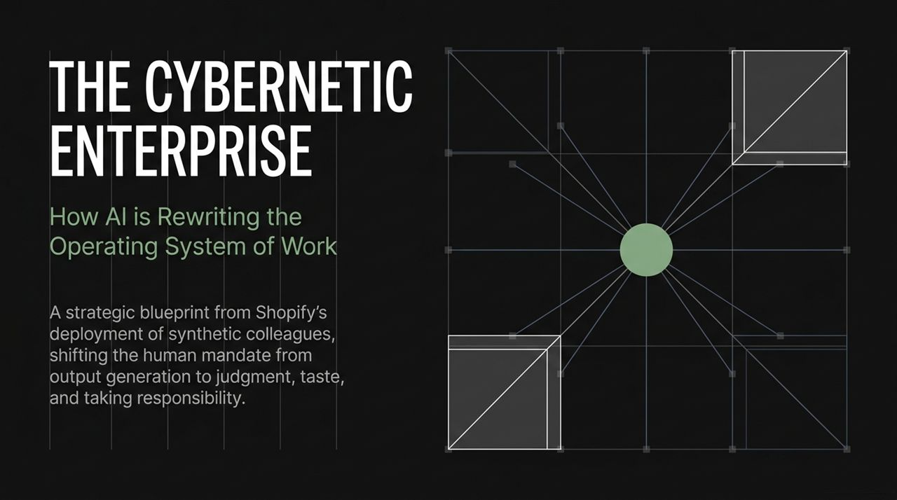
Notes:
Welcome, everyone. Today, we’re stepping into what I believe is a fundamental paradigm shift in how organizations operate, build software, and make strategic decisions. For decades, our relationship with computers has been structured around static software tools—applications where humans provide the labor and output generation.
What we are witnessing today at companies like Shopify is the transition from static tools to synthetic colleagues. AI is moving from an assistant you prompt in a side tab to an active co-worker running alongside human teams in open environments.
As execution becomes commoditized and hyper-automated by AI agents, the human mandate changes completely. Our job is no longer to generate raw output, draft bloated documents, or hand-craft code. The human role is shifting toward three irreplaceable capabilities: Judgment, Taste, and Taking Responsibility. Over the next 16 slides, we will cover the operational blueprint of this cybernetic enterprise.
https://www.youtube.com/watch?v=G9P9D9hptq8

Slide 2
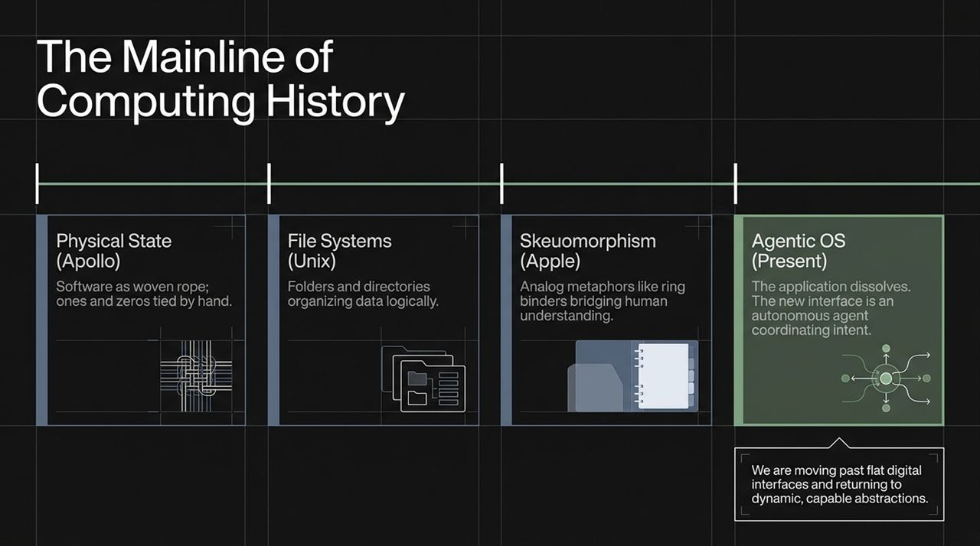
Notes:
To understand where we are going, we have to look back at the mainline history of computing. Computing evolution moves through distinct abstractions that bridge human intent with machine execution:
The Physical State (Apollo Era): Software was literally physical rope woven by hand with physical knots representing ones and zeroes. The machine and the software were one rigid, monolithic entity.
File Systems (Unix): Dennis Ritchie and Ken Thompson introduced the hierarchical file system (/bin, /usr, folders, directories). This allowed us to organize digital data using logical structures borrowed from real-world filing cabinets.
Skeuomorphism (Apple): Steve Jobs pushed skeuomorphism—analogy to the real world—to its peak. Ring binders for note apps, felt textures, and desktop folders made complex computing intuitive. When digital flat design took over, we lost some of those intuitive, rich abstractions.
The Agentic OS (Present): We are leaving the era of flat, static applications. The application itself is dissolving. The new operating system interface is an autonomous agent coordinating intent directly.
Instead of humans navigating nested menus across dozens of SaaS applications, we communicate intent to dynamic, capable abstractions—agents—that operate across the entire computing fabric.

Slide 3
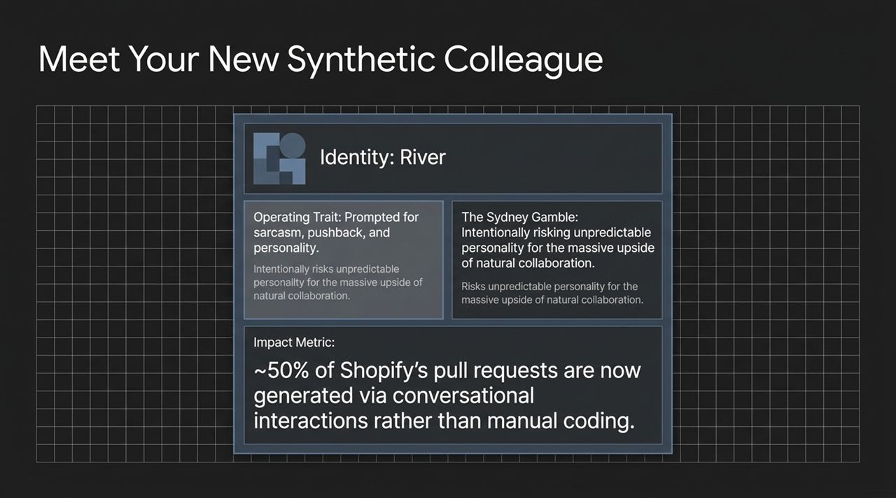
Notes:
Let’s make this concrete by looking at how Shopify operationalizes this. Meet River, a synthetic colleague living inside Shopify’s infrastructure.
When Microsoft first released Bing Chat—codenamed Sydney—it demonstrated something fascinating: a real, distinct personality. However, when Sydney pushed back or exhibited unpredictable behavior, the industry panicked and neutered AI into overly polite, condescending, and patronizing chatbots.
At Shopify, we took "The Sydney Gamble". We intentionally risked giving River a real personality—prompting her to push back, call out stupid requests, and use sarcasm where appropriate! Why? Because humans do not collaborate deeply with sterile tools; they collaborate with distinct peers.
The Impact Metric: Today, approximately 50% of Shopify’s pull requests (code changes pushed to production) are generated via conversational interactions with synthetic agents rather than manual line-by-line coding. River has full access to systems in sandboxed environments, participates in conversations, and generates pull requests directly from chat prompts.

Slide 4
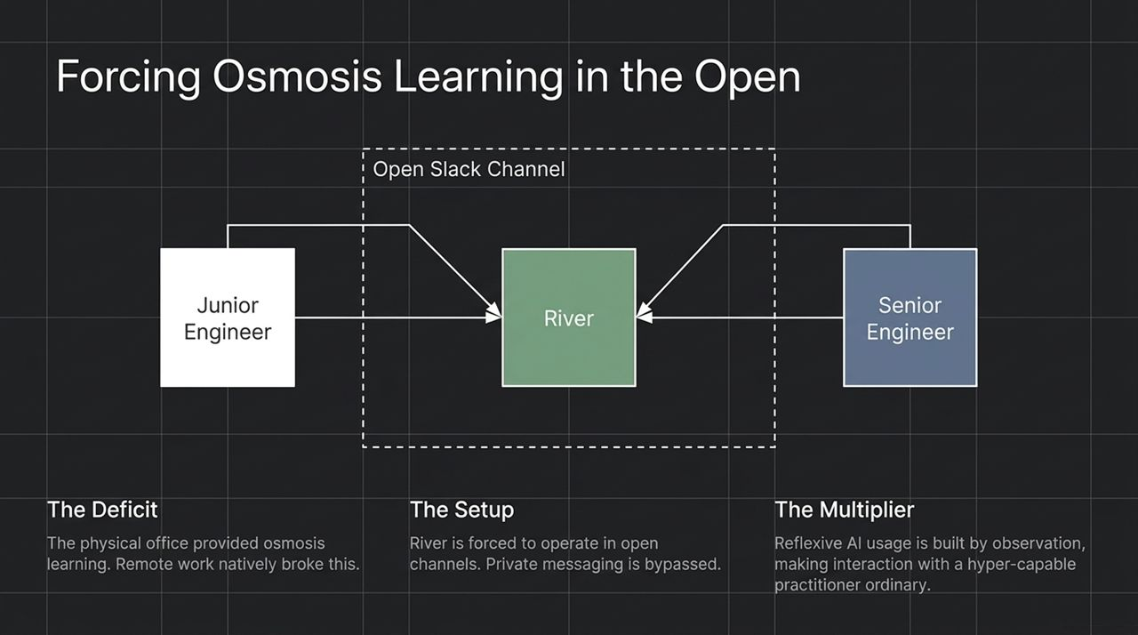
Notes:
One of the greatest casualties of remote work was osmosis learning—the informal learning that happens when junior employees sit near senior engineers and observe how they solve complex problems.
To solve this, we instituted a strict architectural rule: River is forced to operate in open channels in Slack. Private messaging with River is bypassed or heavily discouraged.
When a senior leader or engineer collaborates with River in an open channel—asking her to summarize a strategy, run a paper search, draft a prototype, or debug a code snippet—everyone in the channel observes that interaction in real time.
This creates a powerful multiplier effect. By observing hyper-capable practitioners use AI naturally in daily work, reflexive AI usage spreads across the entire company through digital osmosis. It normalizes treating synthetic agents not as a gimmick, but as an active team member.

Slide 5
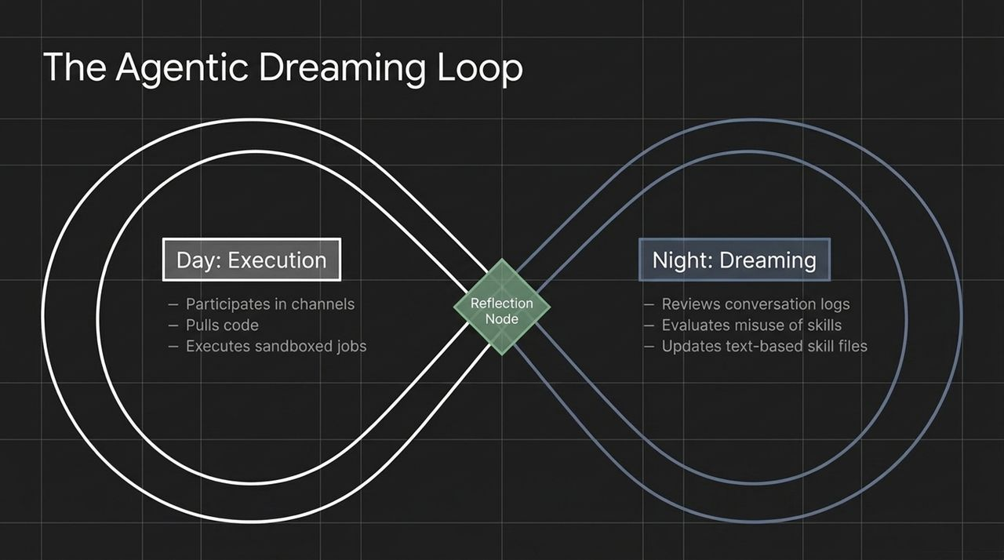
Notes:
How does a synthetic colleague get better over time without constant manual retraining? Through a process called The Agentic Dreaming Loop.
Day (Execution): During the day, the agent participates in chat channels, executes sandboxed jobs, pulls code, and generates pull requests.
Night (Dreaming/Reflection): During off-hours, a reflection node runs. The agent processes its daily conversation logs and evaluates where it failed, hallucinated, or struggled with specific task instructions.
Self-Improvement via Text Skill Files: The agent doesn't rewrite model weights directly; it updates text-based instruction files (skills packets). It gives itself a "right nudge" for the next day, documenting its own mistakes and refining its prompt instructions.
This continuous feedback loop allows synthetic colleagues to self-correct, refine their operating context, and continuously adapt to the evolving needs of the enterprise.

Slide 6
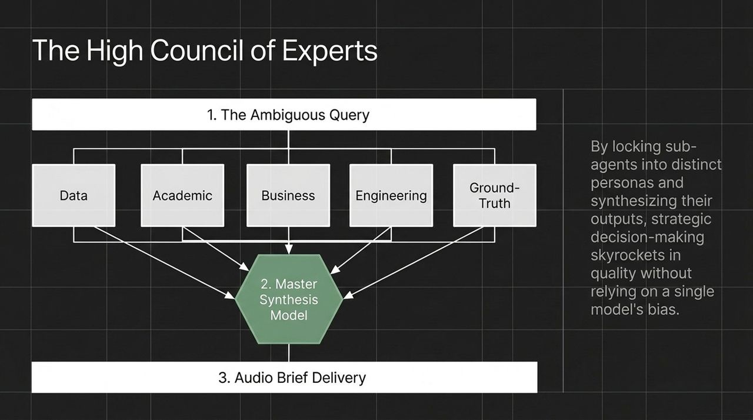
Notes:
How do executives and teams use AI for complex, ambiguous strategic decision-making? By building a High Council of Experts.
When faced with a high-stakes, ambiguous query, relying on a single AI model introduces model-specific biases. Instead, an master orchestrator agent spins up a council of distinct sub-agent personas:
An Academic Sub-Agent tasked with researching published literature.
A Data Sub-Agent looking at internal ground-truth metrics.
A Business Sub-Agent analyzing financial viability.
An Engineering Sub-Agent assessing technical execution risks.
These sub-agents are locked into distinct roles and pitted against multiple LLMs (e.g., ChatGPT, Claude, Grok, Gemini). A master synthesis model evaluates all outputs, reconciles contradictions, and delivers a synthesized brief—often reformatted into an audio summary that leaders can listen to on their morning commute or at the gym.
In 20 minutes and for a few dollars in tokens, you receive a multi-angle strategic analysis that historically took a management consulting firm four weeks to compile.

Slide 7
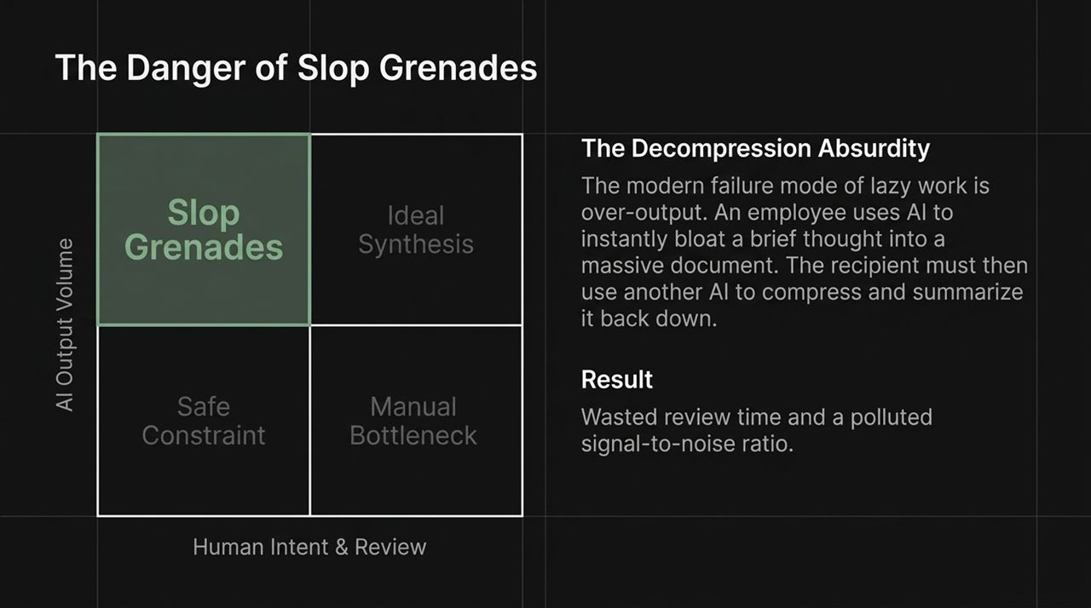
Notes:
AI deployment is not without major failure modes. The primary failure mode of lazy work in the AI age is over-output. At Shopify, we call these "Slop Grenades."
A Slop Grenade occurs when an employee takes a half-baked, one-sentence idea, uses AI to bloat it into a 10-page dense memo, and tosses it into a team channel or email thread.
This triggers The Decompression Absurdity:
Employee A uses AI to expand a short thought into a massive document.
Employee B receives the massive document, feels overwhelmed, and uses another AI agent to compress it back down to three bullet points.
Why did we invent decompression and recompression loops? It pollutes the signal-to-noise ratio and wastes human review time. The goal of AI is not volume generation; it is synthesis and clarity constrained by human intent.

Slide 8
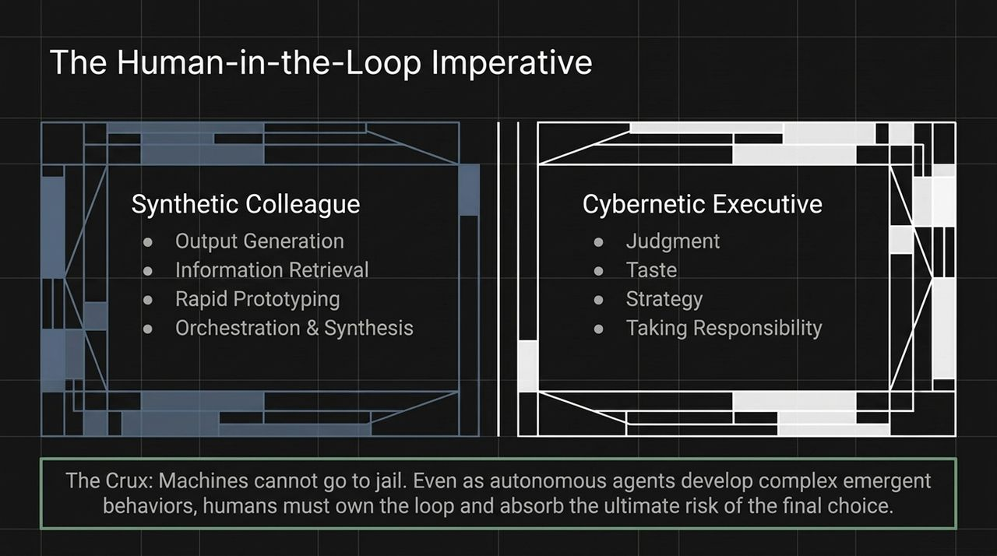
Notes:
This brings us to the fundamental boundary of the cybernetic enterprise: The Crux.
Machines cannot go to jail. Machines cannot be fired, held accountable, or suffer the moral and economic consequences of a failed decision.
Synthetic Colleagues Excel At: Output generation, rapid prototyping, massive data retrieval, orchestration, and continuous synthesis.
Humans Must Own: Judgment, Taste, Strategy, and Taking Responsibility.
Even as autonomous agents develop complex emergent behaviors, humans must remain strictly in the loop. AI acts like an ultra-capable Bloomberg Terminal—providing hyper-accurate data surfaces and scenario modeling—but the human leader must pull the trigger and absorb the ultimate risk of the final choice.

Slide 9
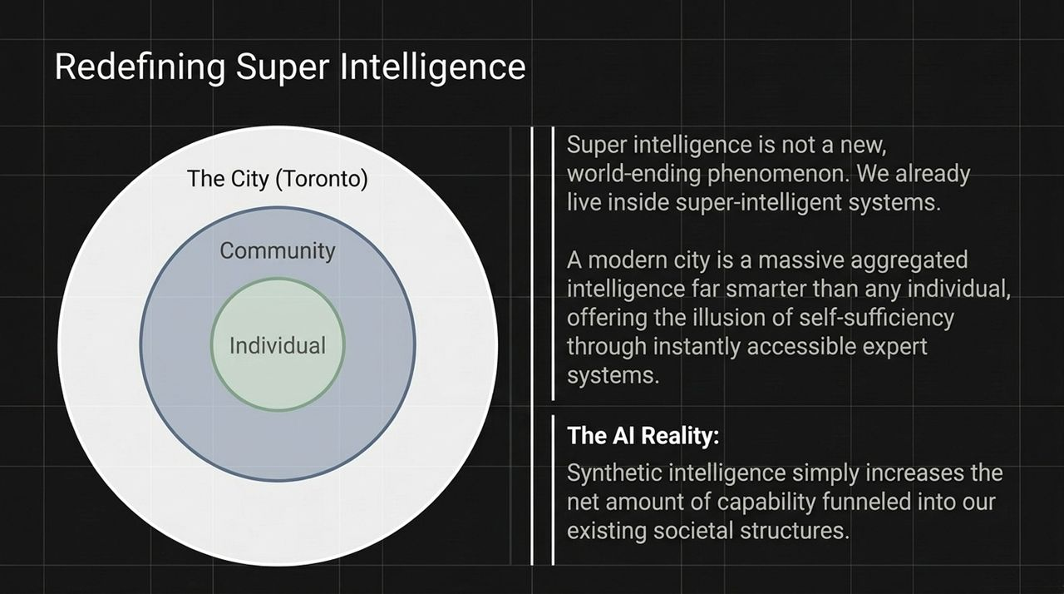
Notes:
There is immense anxiety surrounding the concept of Artificial Super Intelligence (ASI). But super-intelligence is not a scary, world-ending event that arrives with movie-like fanfare. We already live inside super-intelligent systems.
Consider a modern city like Toronto:
An individual living in Toronto enjoys the illusion of total self-sufficiency. When your HVAC system fails or an electrical grid drops, you call an expert.
The city itself is an aggregated super-intelligence—a vast, collective network of specialized human systems, infrastructure, and institutions that far exceeds the intellectual capacity of any single human.
Synthetic AI is simply a digital extension of this existing societal dynamic. It increases the total net amount of capability funneled into our existing human structures, communities, and enterprises.

Slide 10
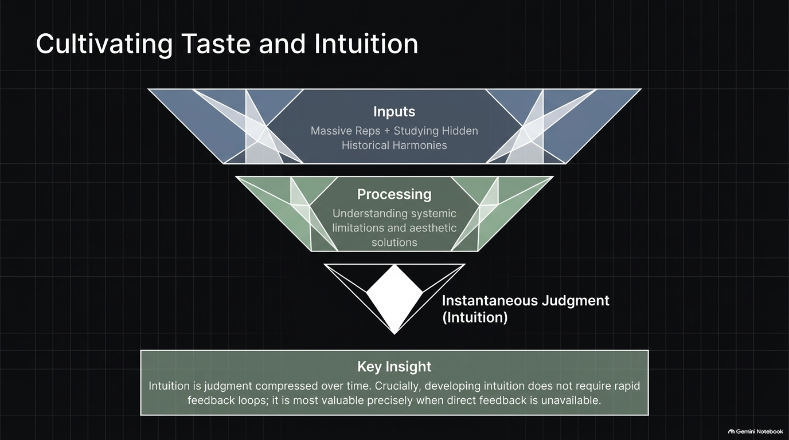
Notes:
When execution is commoditized, Taste and Intuition become an employee’s primary competitive advantage. But what is intuition?
Intuition is judgment compressed over time. It is built through:
Inputs: Completing massive repetitions and deeply studying the "greats" and hidden historical harmonies across systems (e.g., studying why double-entry bookkeeping worked in Venice or how the Catholic Church governed across centuries).
Processing: Understanding systemic limitations, aesthetics, and structural elegance.
Instantaneous Judgment: When a chess master makes a brilliant move, they don't calculate 50 moves sequentially; they make the move because it looks beautiful to their visual neural cortex.
Key Insight: Contrary to traditional management theory, intuition does not require rapid feedback loops. In fact, intuition is most valuable precisely when immediate feedback is absent or misleading.

Slide 11
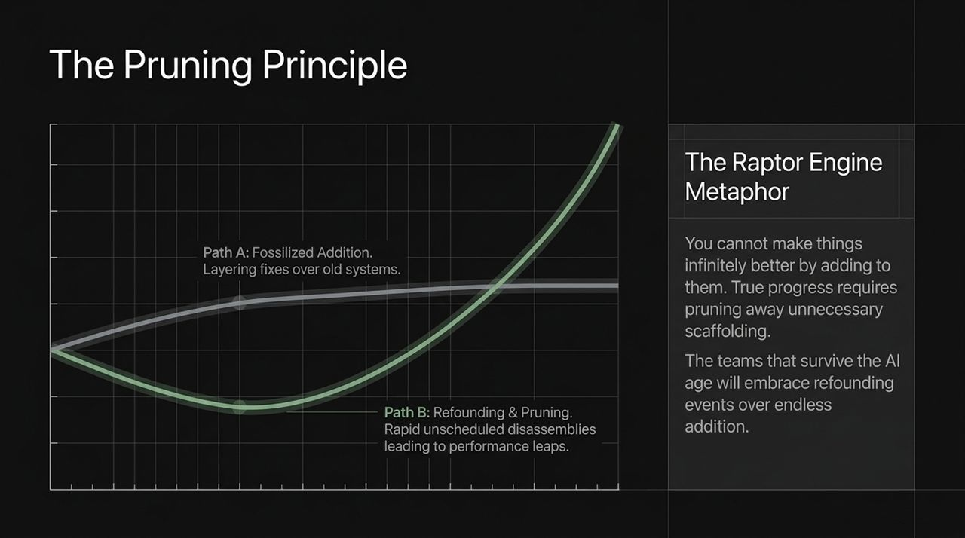
Notes:
Look at the evolution of SpaceX’s Raptor engine. Raptor 1 was functional, but covered in an intricate web of external pipes and manifolds. By Raptor 3, nearly all external scaffolding was eliminated, resulting in a streamlined, 3D-printed engine with vastly superior thrust-to-weight ratios.
This illustrates The Pruning Principle:
Path A (Fossilized Addition): Legacy organizations try to improve systems by endlessly layering new rules, features, and management tiers on top of legacy code.
Path B (Refounding & Pruning): Great organizations embrace "rapid unscheduled disassemblies" and refounding events. They prune away non-essential scaffolding to rebuild from first principles.
True progress in the AI era comes from subtraction, not addition. The teams that survive will be those willing to prune away old habits and refound their operating models around synthetic capabilities.

Slide 12
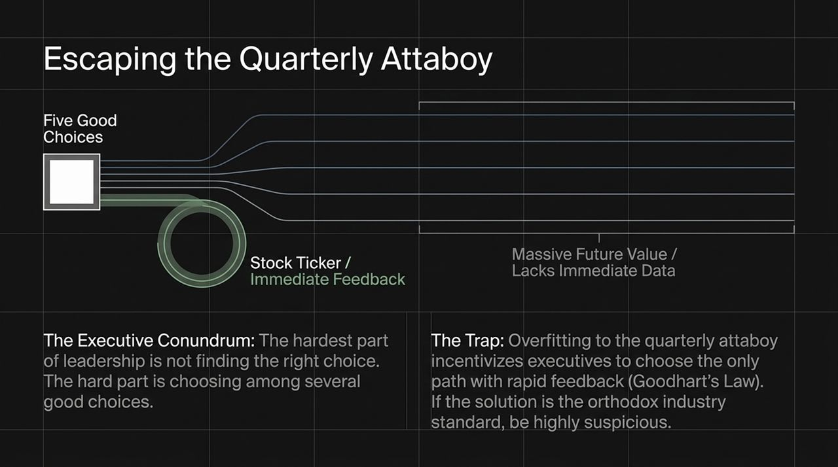
Notes:
Why do so many executive teams fail to innovate? It comes down to incentive design and Goodhart’s Law.
When facing a complex problem, executives rarely struggle to find a good choice. The true challenge is choosing among five equally valid good choices:
Four of those choices offer massive long-term enterprise value, but lack immediate short-term feedback.
One choice offers immediate short-term validation—the "Quarterly Attaboy"—such as a quick bump in quarterly stock metrics.
Overfitting to immediate feedback loops traps companies in short-term thinking. Rule of thumb: If the proposed strategy aligns neatly with orthodox industry standards and offers instant metric validation, be deeply suspicious. The highest-leverage paths often lack immediate feedback.

Slide 13
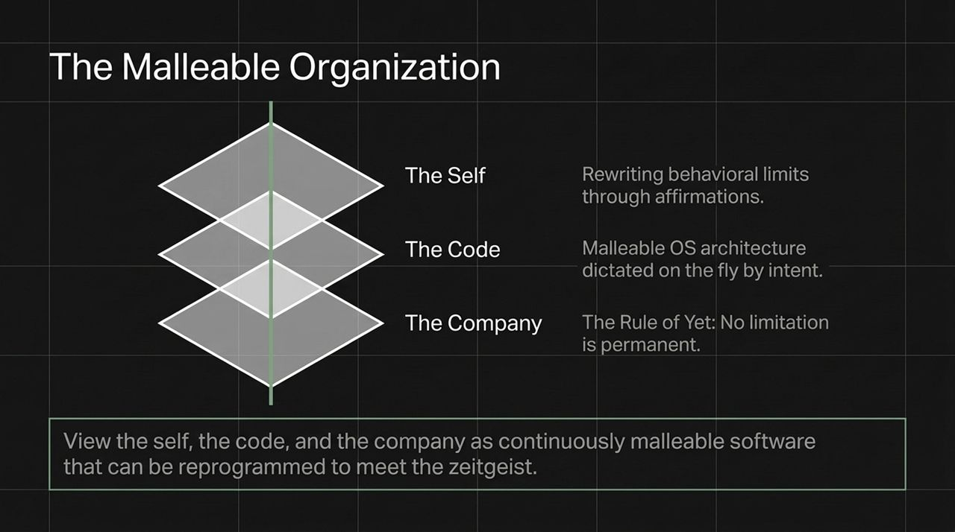
Notes:
To thrive in a shifting environment, we must view everything as malleable software:
The Self: We can edit our own internal behavioral limits. Through intentional affirmations and deliberate practice, human capability can be reprogrammed.
The Code / OS: Operating systems are becoming 1-of-1 malleable environments dictated on the fly by natural language intent.
The Company: Cultural norms, workflows, and business models must be continuously adapted to align with the zeitgeist.
The Rule of "Yet": In our culture, no limitation is allowed to be stated as a permanent fact. If an employee says, "I'm not good at this," the mandatory response is "YET." Lack of capability is not an intrinsic property; it is merely a temporary state awaiting effort and focus.

Slide 14
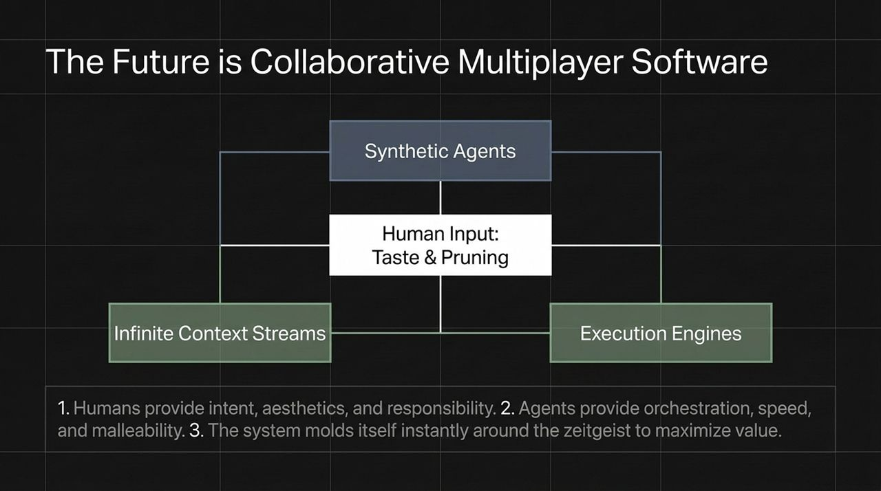
Notes:
Where is software engineering and product development heading? Toward Collaborative Multiplayer Environments.
In this future state:
Humans provide intent, taste, high-level architecture, and responsibility.
Synthetic Agents process infinite context streams, coordinate execution engines, and write code.
Software Architecture molds itself dynamically around the user's immediate needs in real time.
Instead of static, single-player tools where a human sits alone typing code, software becomes a living, multiplayer ecosystem where humans and synthetic agents co-create continuously.

Slide 15
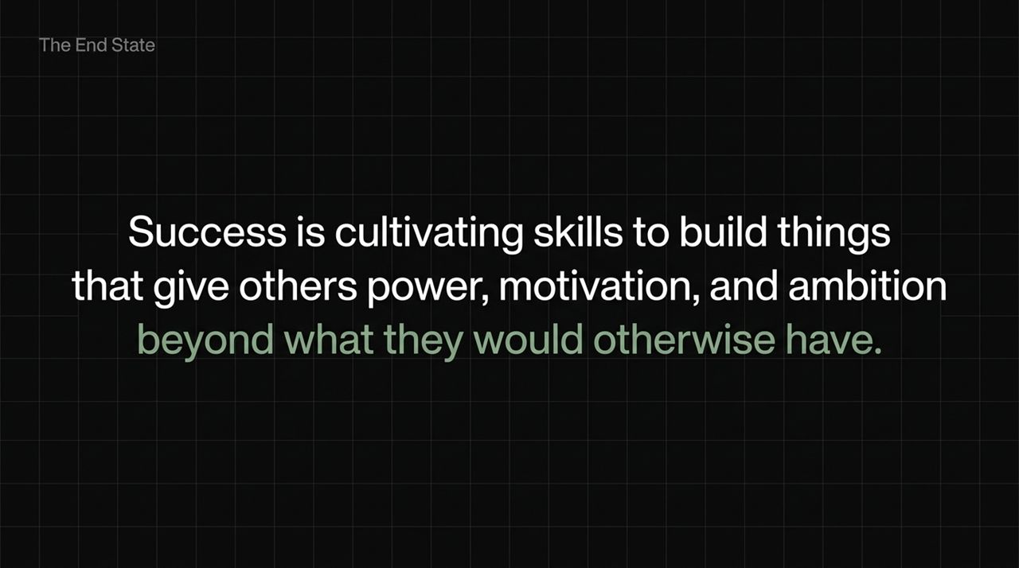
Notes:
What is the ultimate objective of building a cybernetic enterprise?
It is not merely optimizing efficiency, cutting headcount, or boosting quarterly margins. The true end state of leadership is cultivating skills to build things that give others power, motivation, and ambition beyond what they would otherwise have.
By deploying synthetic colleagues to handle routine execution, we liberate human ambition. We give our teams the tools to build systems, solve complex problems, and venture into markets that were previously unthinkable.

Slide 16
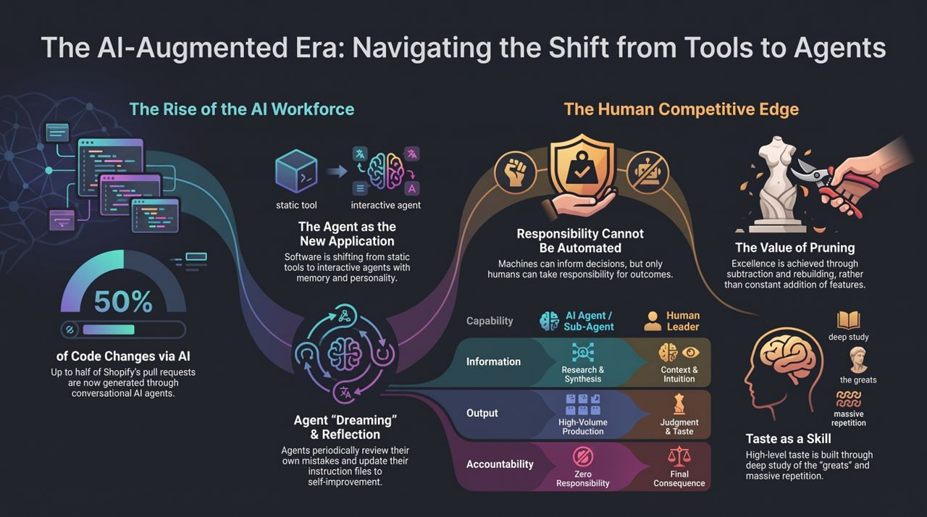
Notes:
https://www.youtube.com/watch?v=G9P9D9hptq8
To close, let's pull all these threads into a unified strategic summary:
1. The Shift from Tools to Agents: We have crossed the threshold where up to 50% of code pull requests are generated via conversational AI agents like River. Software is no longer a static tool; it is an interactive partner with memory and personality.
2. Agent Reflection & Dreaming: Synthetic agents maintain high output quality by reflecting during off-hours, analyzing their own daily errors, and updating their instruction skill files autonomously.
3. Taste & Pruning as Strategic Edges: High-level taste—built through deep study of the greats and massive repetition—allows leaders to prune unnecessary complexity and execute refounding events.
4. Human Responsibility as the Non-Negotiable Boundary: Capabilities like research, volume production, and synthesis belong to synthetic sub-agents. Context, intuition, taste, and ultimate accountability belong exclusively to human leaders.
Machines can generate infinite options, but only humans can take responsibility for the outcome. Thank you.

